Slide 1


Unemployment Analysis
Taking the Help of Python – 10 Plots

Slide 2
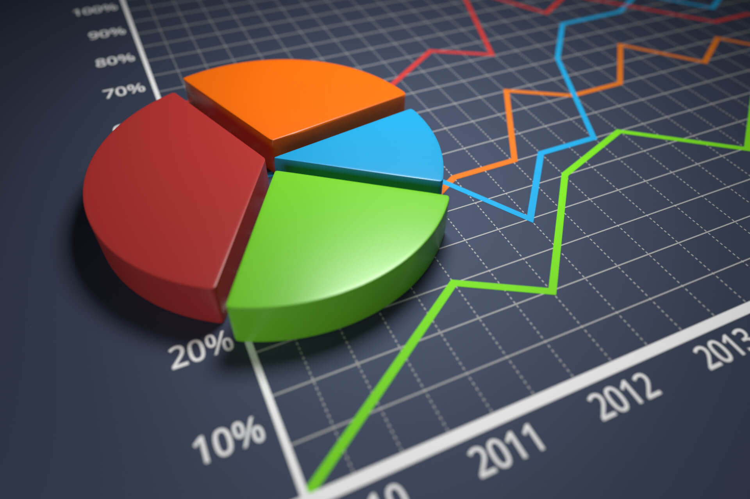
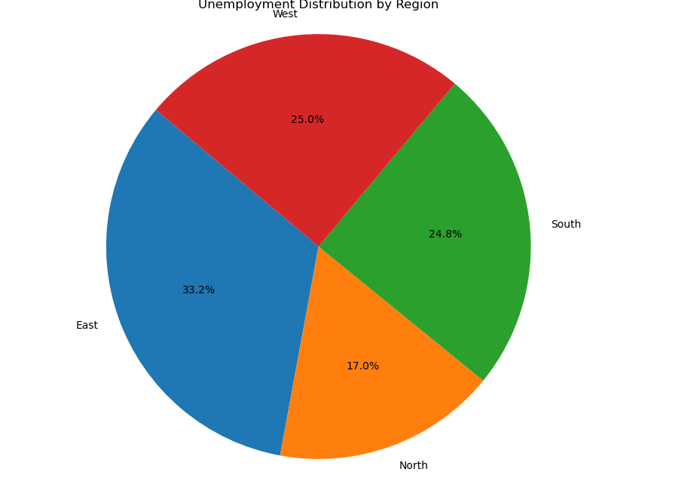
Pie Chart

Slide 3
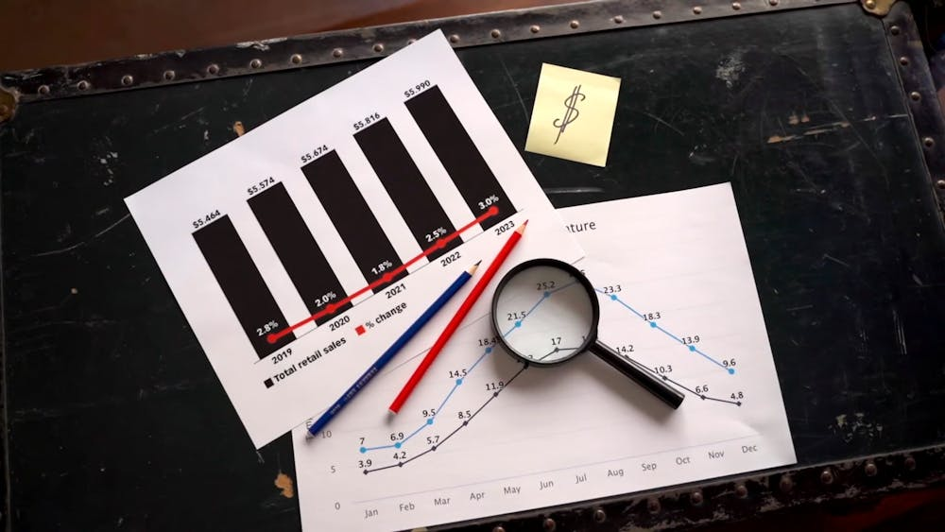
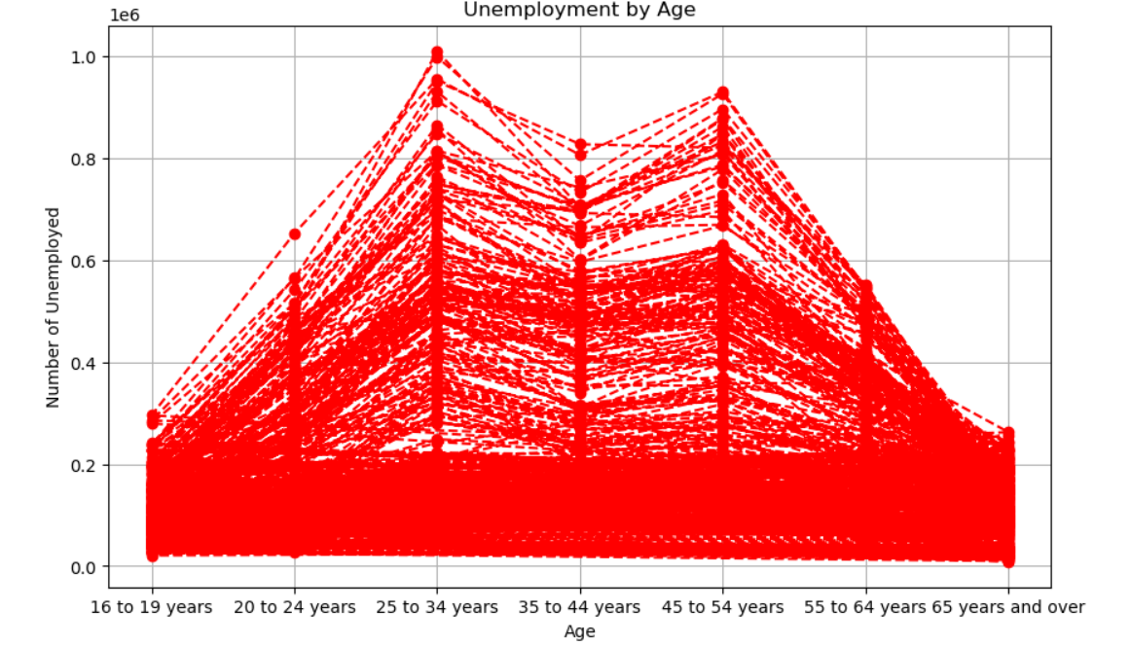
Pie Chart

Slide 4

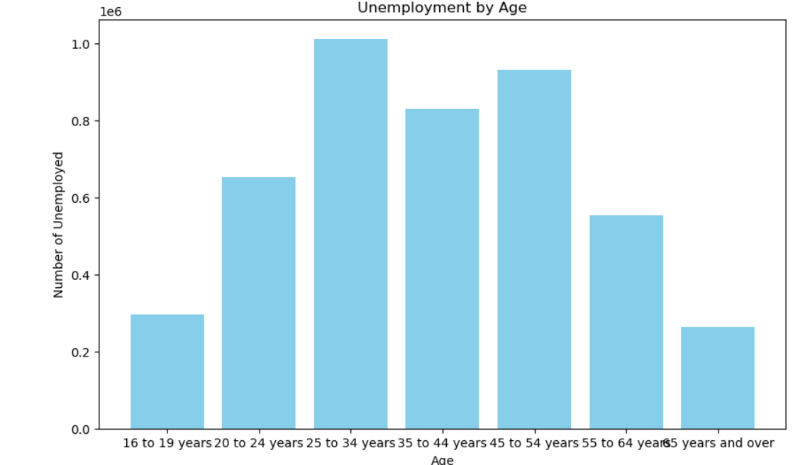

Bar Plot

Slide 5
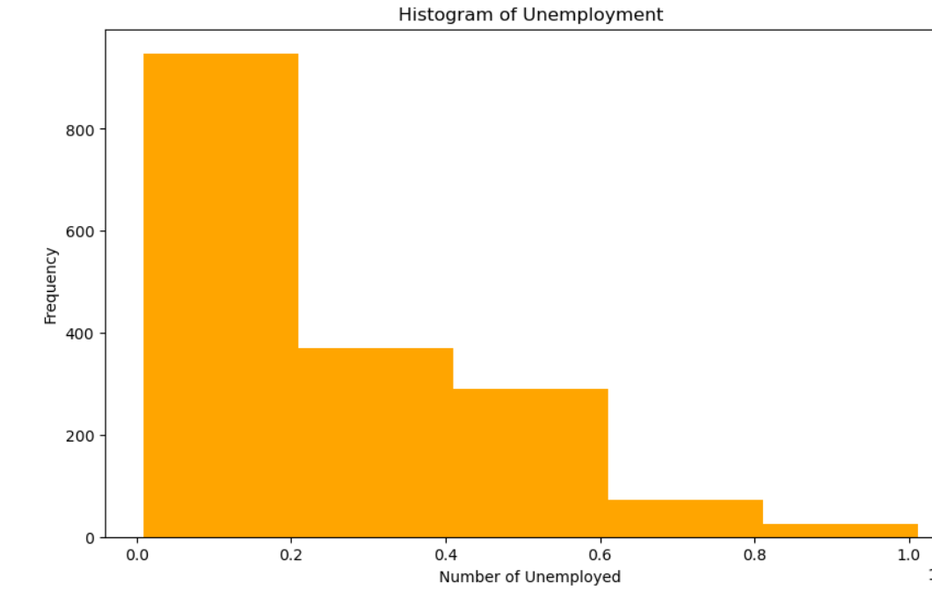
Histogram

Slide 6
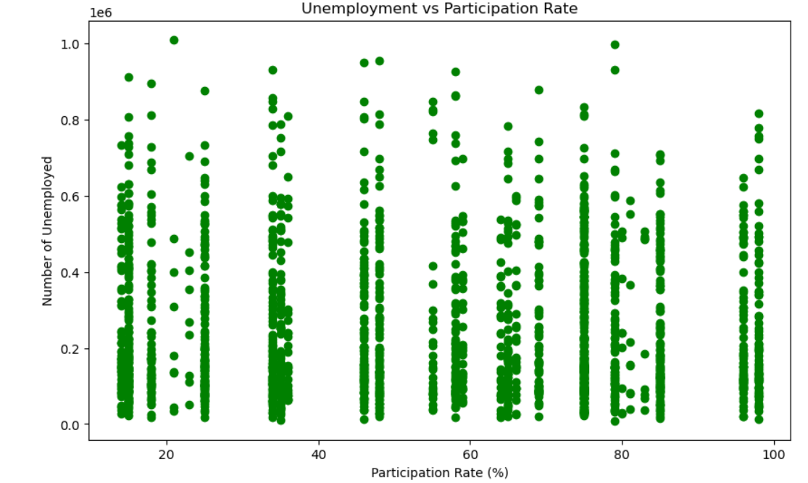
Scatter Plot

Slide 7
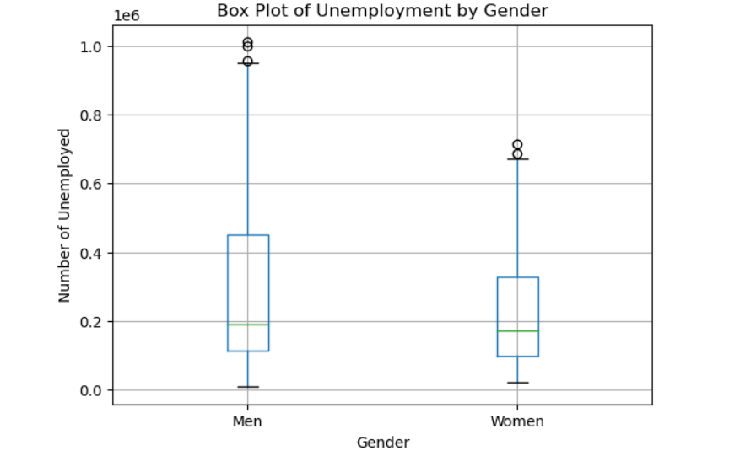
Box Plot

Slide 8
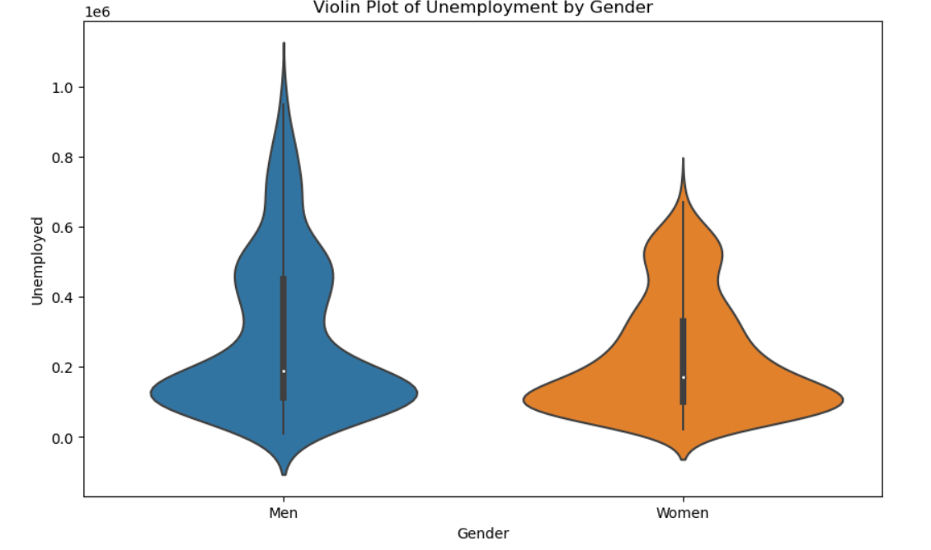
Violin Plot

Slide 9
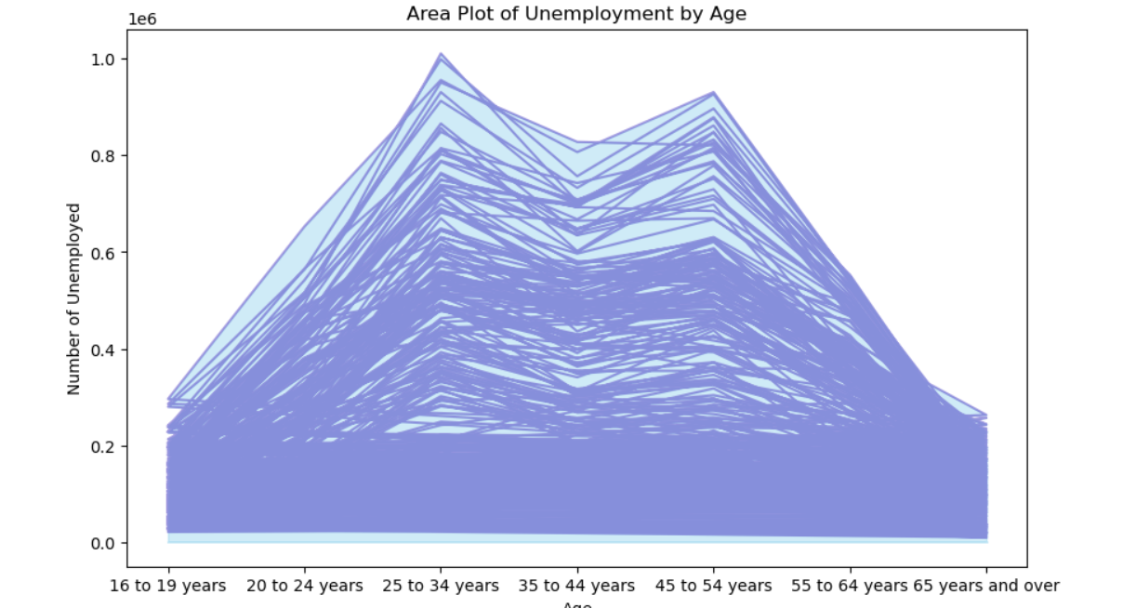
Area Plot

Slide 10
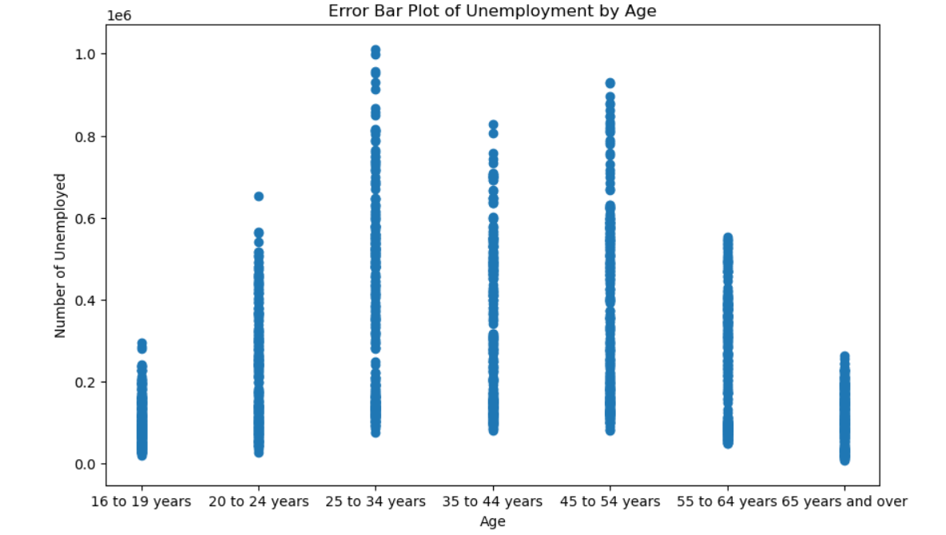
Error Bar Plot

Slide 11
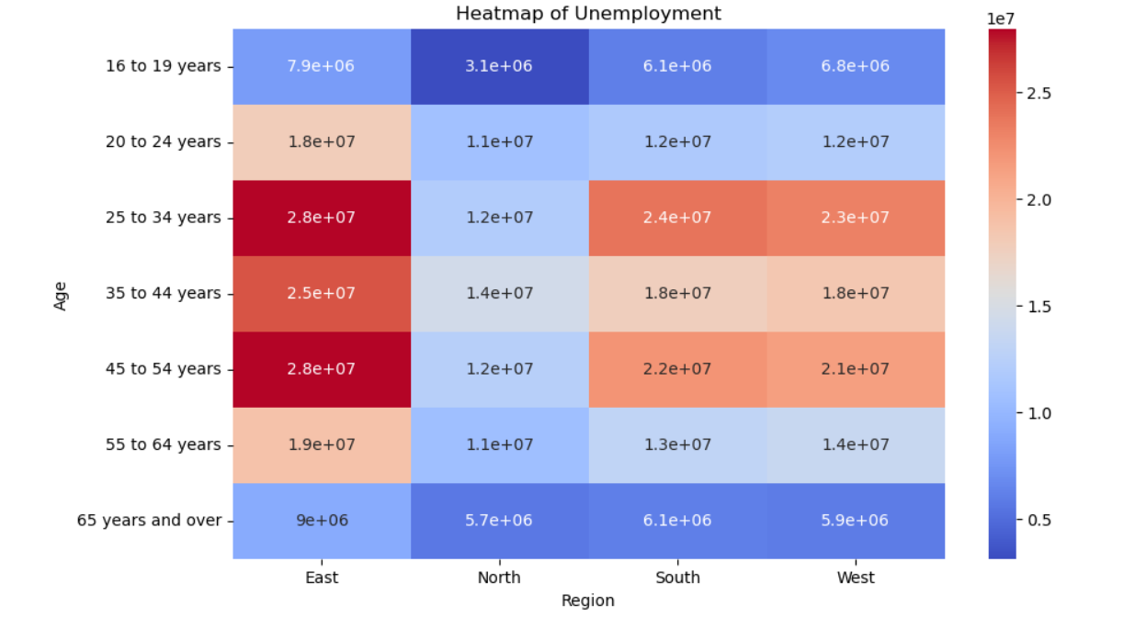
Pie Chart

Slide 12
The visualizations highlighted key patterns and trends.
Thank You
Subham Choudhary

